Slide 1

Docker Privew
kewei

Slide 2
Why Use Docker
Before Docker containers
Deployed on “bare metal”
Hard to move
Hard to update
Virtual machine
Share physical system
Effectively accomplish business req
Cut cost
To large(memory, disk)
Deliver speed is limited
Notes:
VM allowed multiple virtual machines to share a single physical system,
more effectively to changes in business requirements, because VMs could be cloned, copied, migrated, and spun up or down to meet demand or conserve resources.

Slide 3
Docker container benefits
Docker enables more efficient use of system resources
less memory
start up and stop more quickly
cost lower than VM
Docker enables faster software delivery cycles
deploy quickly

Slide 4
Docker container benefits
Docker enables application portability
shuttled easily between environments(dds sample)
service runtime installed(for developing)
Docker shines for microservices architecture
Lightweight, portable, and self-contained
microservices(bs-submodules by separate teams and on separate timelines)

Slide 5
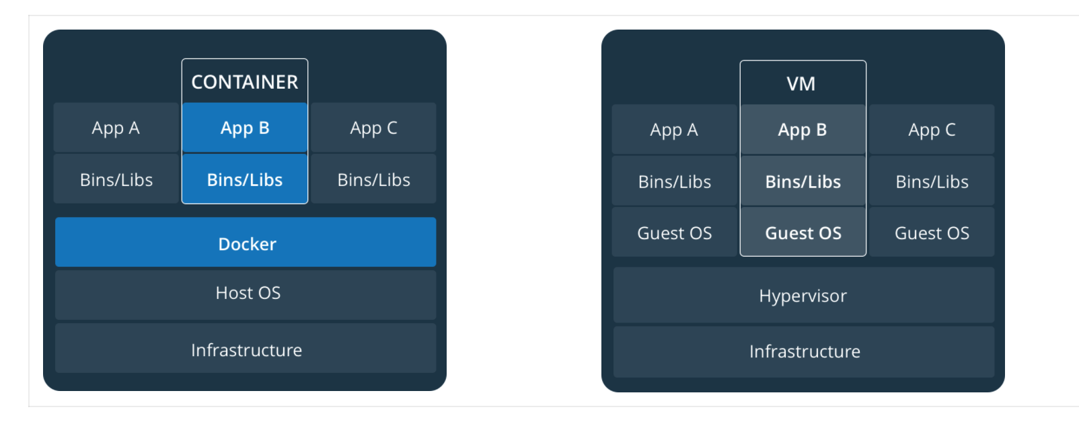
Architecture
Notes:
镜像和容器
从根本上讲，一个容器不过是一个正在运行的进程，并对其应用了一些附加的封装功能，以使其与主机和其他容器隔离。 容器隔离的最重要方面之一是每个容器都与自己的专用文件系统进行交互。 该文件系统由Docker映像提供。 映像包括运行应用程序所需的所有内容-代码或二进制文件，运行时，依赖关系以及所需的任何其他文件系统对象。
容器和虚拟机
容器在Linux上本地运行，并与其他容器共享主机的内核。 它运行一个离散进程，不占用任何其他可执行文件更多的内存，从而使其轻巧。
相比之下，虚拟机（VM）运行具有“虚拟机管理程序”对主机资源的虚拟访问权的成熟“来宾”操作系统。 通常，VM会产生大量开销，超出了应用程序逻辑所消耗的开销。

Slide 6
Basic command
docker pull
https://hub.docker.com/
docker images
docker run –it –name container_name image_name:tag
docker stop
docker ps –a
docker rm –f container_name
docker rmi image_name
docker exec –it container_name bash –c “”
docker logs –f container_name
docker save –o “image_name.tar” image_name:tag
docker load –i “image_name.tar”

Slide 7
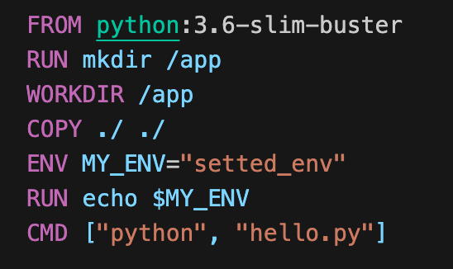
Dockerfile
https://github.com/summy00/dockerfile_sample.git
FROM
COPY
RUN
ENV
WORKDIR: affect COPY dest
CMD
ENTRYPOINT
VOLUME
Notes:
There can only be one CMD instruction in a Dockerfile. If you list more than one CMD then only the last CMD will take effect.
The main purpose of a CMD is to provide defaults for an executing container. These defaults can include an executable, or they can omit the executable, in which case you must specify an ENTRYPOINT instruction as well.
The WORKDIR instruction sets the working directory for any RUN, CMD, ENTRYPOINT, COPY and ADD instructions that follow it in the Dockerfile.

Slide 8
Docker Build
docker build -f dockerfile -t my_docker_image:tag build_context_directory
-f: docker file path
-t: image_name:tag pattern

Slide 9

Build Context
docker build -f dockerfile -t my_docker_image:tag .
When you issue a docker build command, the current working directory “.” is called the build context.
All recursive contents of files and directories in the current directory are sent to the Docker daemon as the build context.
affected COPY source

Slide 10
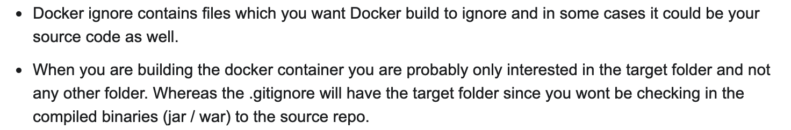
Exclude with .dockerignore
compatible with ”.gitignore”
helps to avoid unnecessarily sending large or sensitive files and directories to the daemon and potentially adding them to images using ADD or COPY.
https://github.com/github/gitignore/blob/master/Python.gitignore
https://github.com/github/gitignore/blob/master/Node.gitignore
https://stackoverflow.com/a/58709942/2268680

Slide 11
Docker Run
docker run –idt –rm –-name container_name image_name:tag cmd
-i
-t
-d
--rm
--name
cmd
-v
-p: node_sample
--network
Notes:
-d: tail -f /dev/null

Slide 12
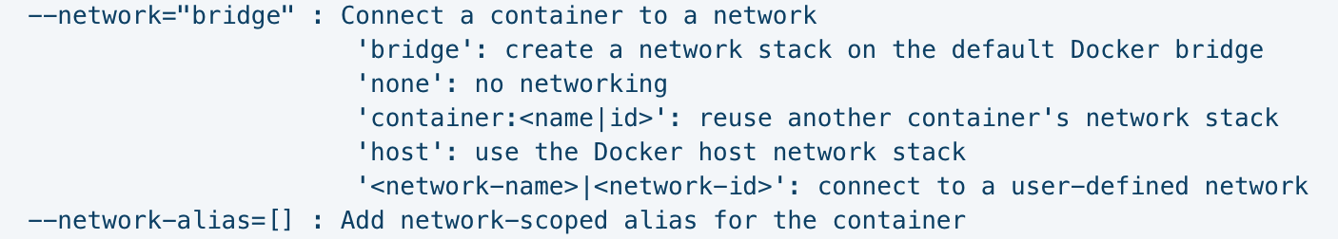
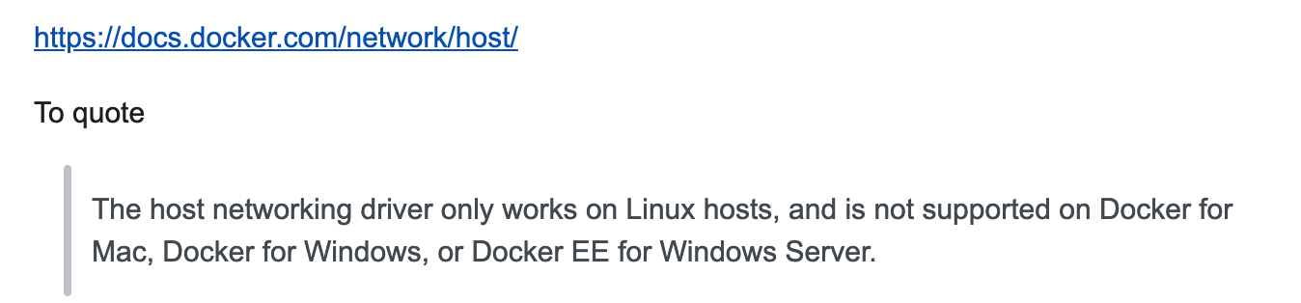
Docker Run --network
Notes:
--network="bridge" : Connect a container to a network
'bridge': create a network stack on the default Docker bridge(default)
Compared to the default bridge mode, the host mode gives significantly better networking performance
since it uses the host’s native networking stack whereas the bridge has to go through one level of virtualization
through the docker daemon. It is recommended to run containers in this mode when their networking performance is critical,
for example, a production Load Balancer or a High Performance Web Server.

Slide 13
Docker Inspect
docker inspect container_name

Slide 14
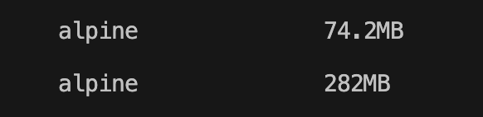
Multi-Stage Build

Slide 15

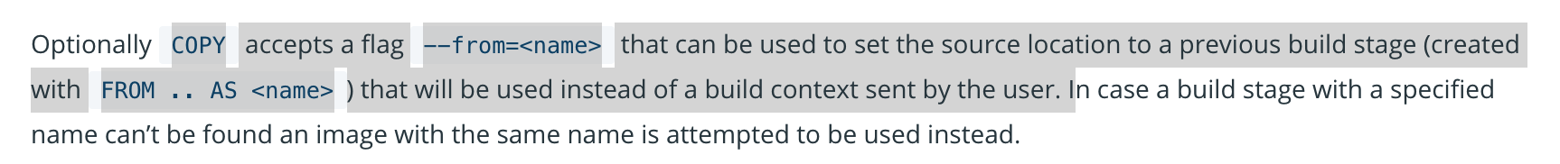
Multi-Stage Build

Slide 16
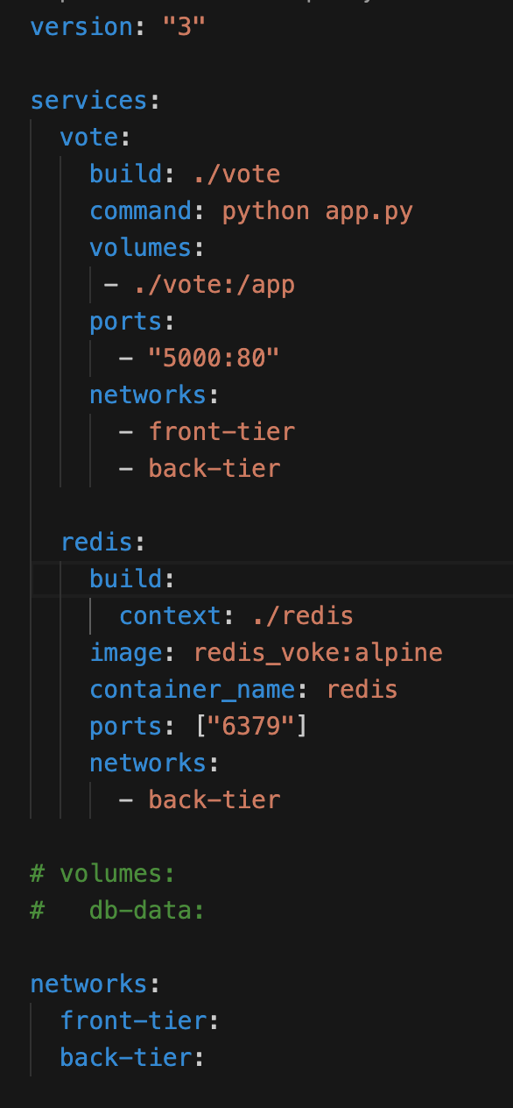
Docker-compose

Slide 17
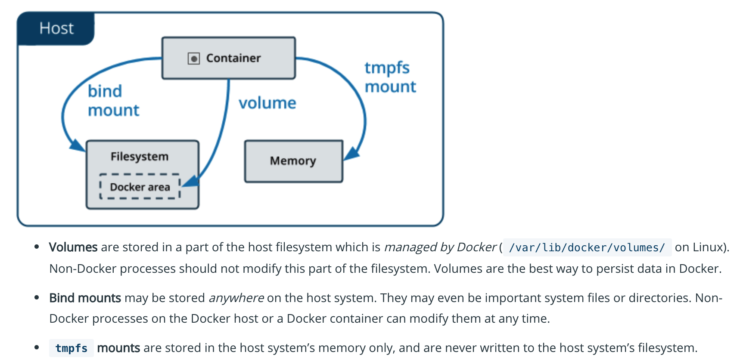
Manage data in Docker

Slide 18
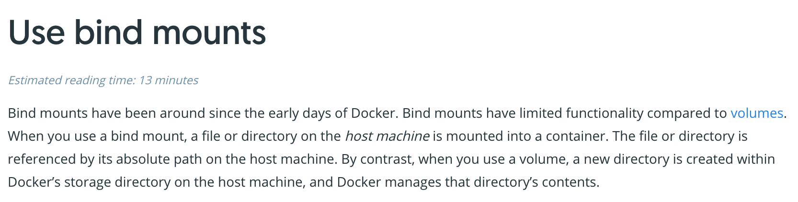
Bind

Slide 19
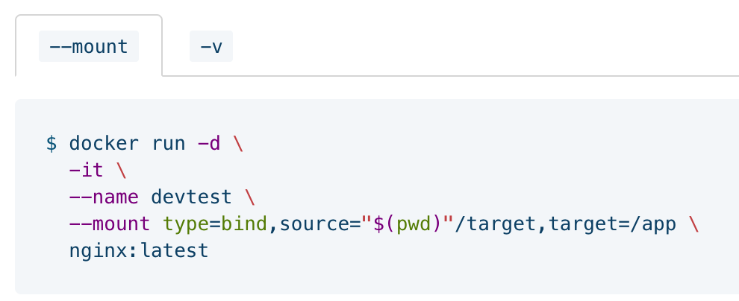
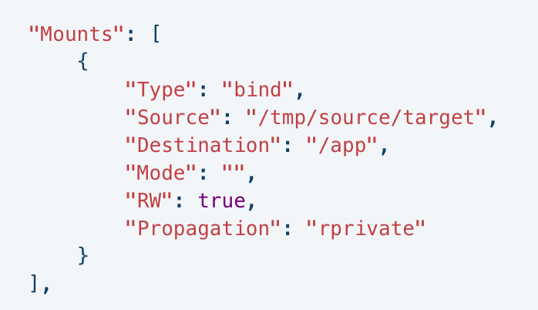
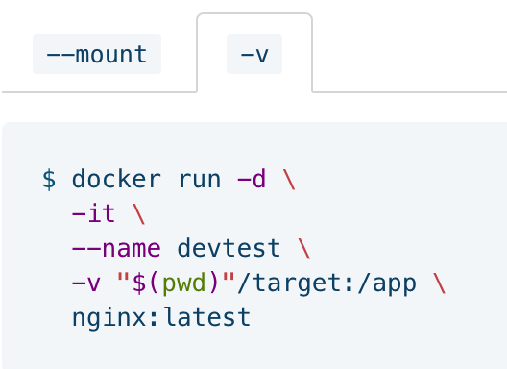
Bind in docker run

Slide 20
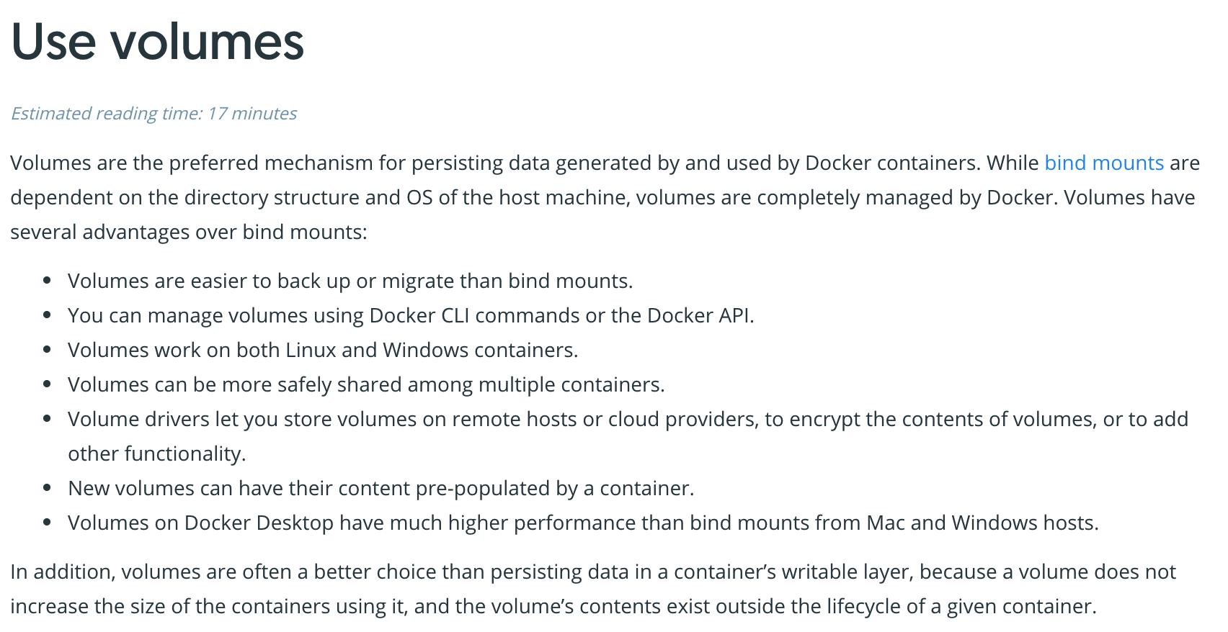
Volumes

Slide 21
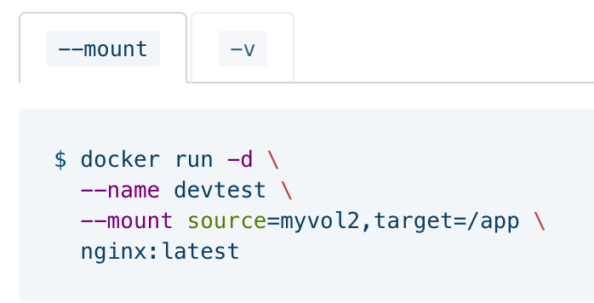
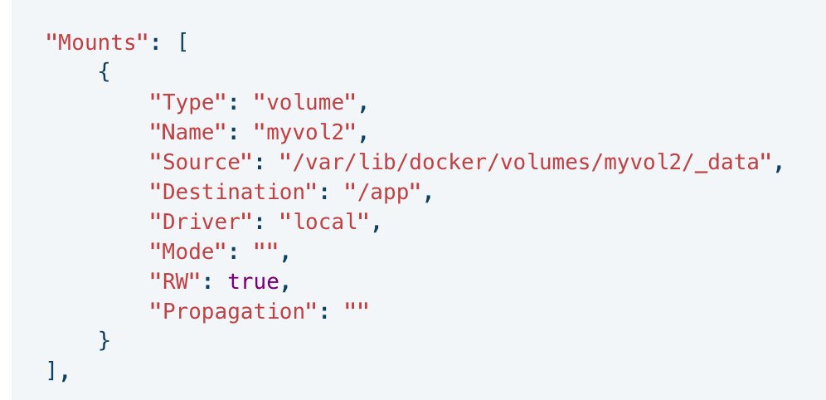
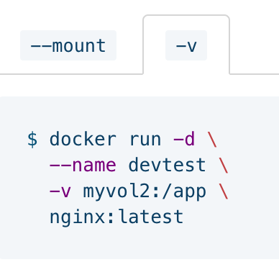
Volume in docker run

Slide 22
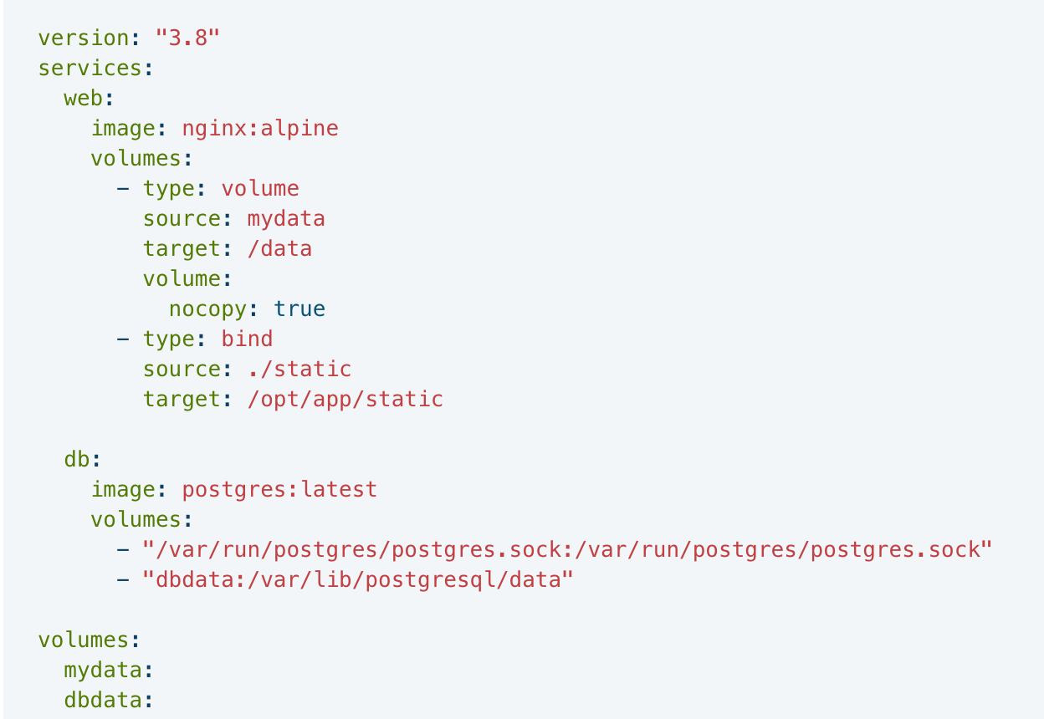
bind/volume in docker-compose

Slide 23
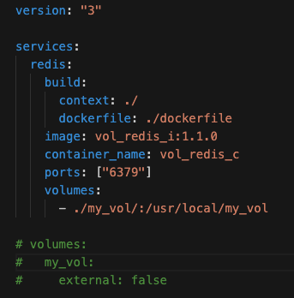
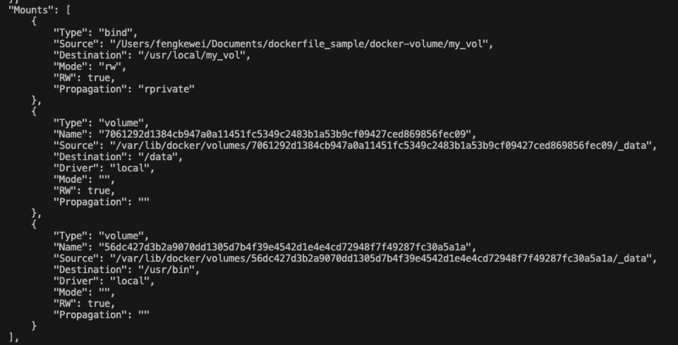
Docker Volume

Slide 24
Volume
https://docs.docker.com/storage/volumes/
https://stackoverflow.com/questions/41935435/understanding-volume-instruction-in-dockerfile

Slide 25
reference
https://docs.docker.com/engine/reference
https://www.infoworld.com/article/3310941/why-you-should-use-docker-and-containers.html

